Slide 1

Athlemax
Ad campaign performance review
Analyzing the Effectiveness of Instagram Ad formats
Yakuub Adam | Marketing Data analyst

Slide 2
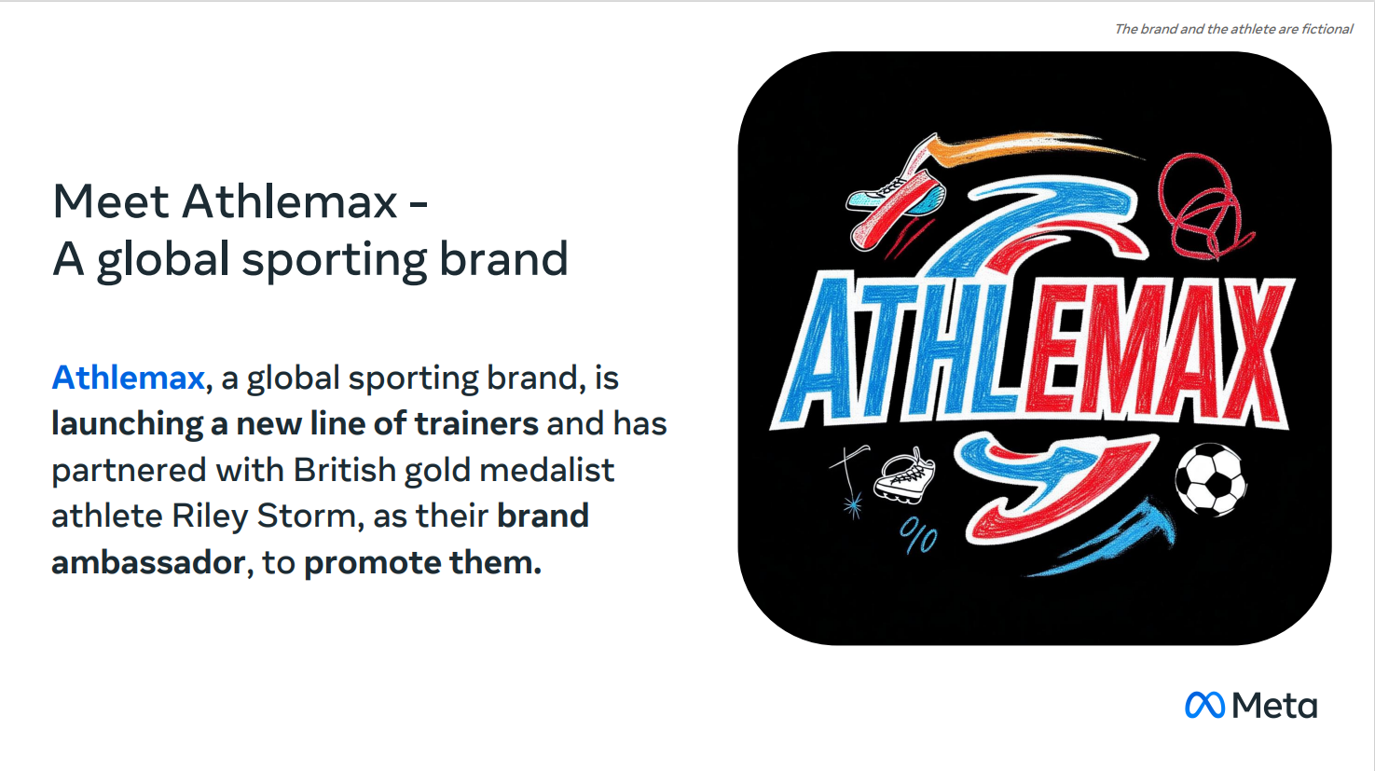
MEE

Slide 3
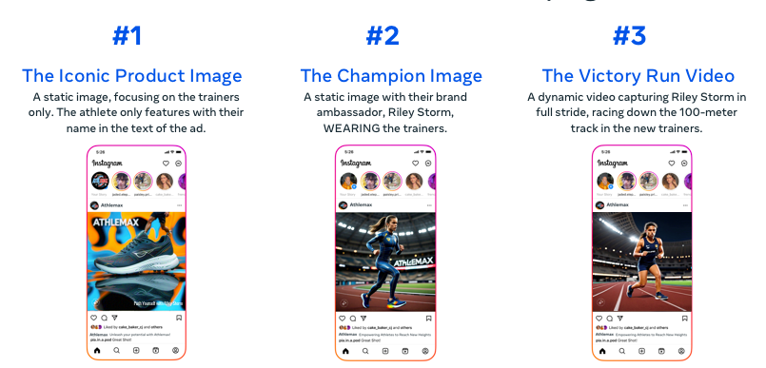
Campaign Overview
Athlemax have pretested 3 ads on Instagram with a small advertising budget during today we will discuss the effectiveness and some key insights
Athlemax tested three types of ads static product, static athlete + product and video athlete + product
The key business goals were to increase user engagement , driving web traffic and boosting sales

Slide 4
Metrics Overview
Conversion Rate % (CVR) = Total Purchases / Total exposed users x 100
Measures how often people purchase a product after seeing the ad
Engagement Rate % (ER)= Total Engagement (Likes, Comments, Clicks) / Total impression x 100
Measures how often people engage on ad compared to how many times it was shown
Click-through rate % (CTR) = Total Clicks / Total impressions x 100
Measures how often people click on ad compared to how many times it was shown

Slide 5
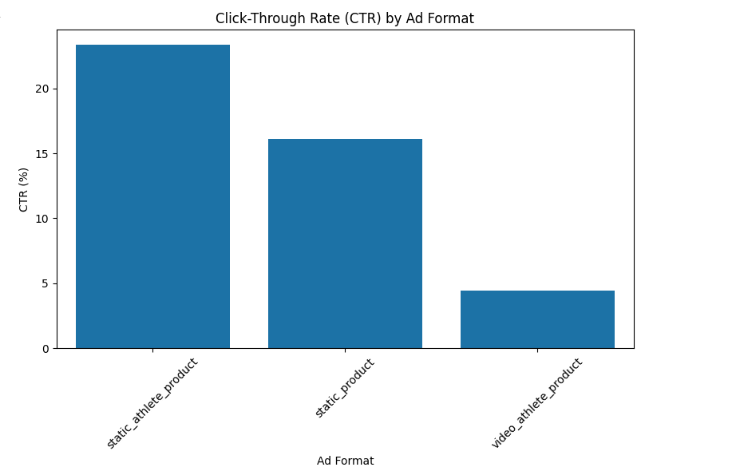
Click Through rate (CTR)
CTR measures how often people see an ad and click on it.
Click Through Rate – The static athlete + product ad had the highest CTR at 23.4%, this shows that it was the most successful at enticing people to click on the ad.

Slide 6
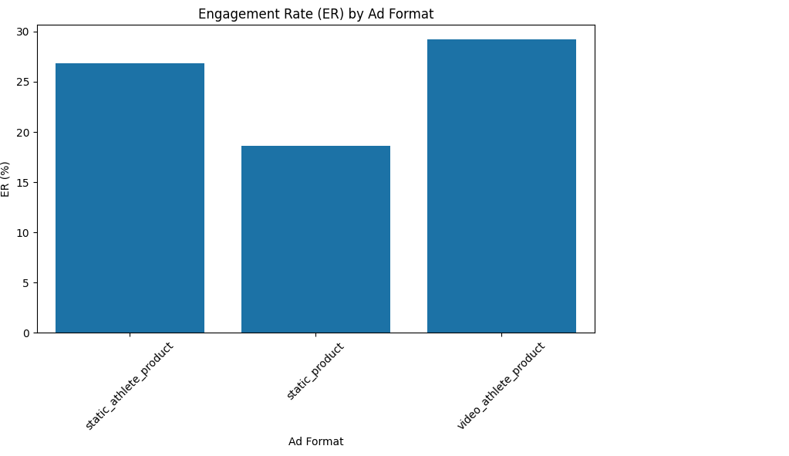
Engagement rate (ER)
ER shows how often people engaged with the ad .
Key insights : The video (athlete + product) ad had the highest engagement rate at 29.21%, suggesting its generated the most interaction overall.

Slide 7
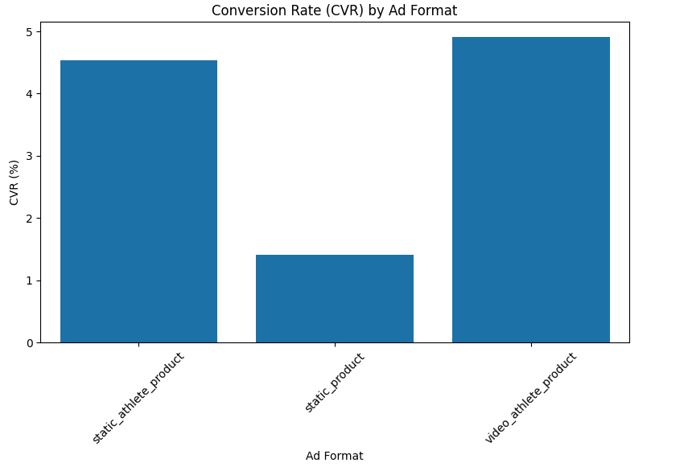
Conversion rate (CVR)
CVR measure how much users made a purchase after seeing the ad .
Key insights: The video (athlete + product ) ad had the highest conversion rate at 4.91%, meaning it was the most effective at driving actual sales.

Slide 8



Executive summary
Video ad (athlete + product): Highest engagement (29.2% ER) and conversion (4.9% CVR) recommend prioritizing for main campaign to maximize sales and interactions.
Static ad: Highest click-through rate (23.3% CTR) use selectively for retargeting or cost-efficient traffic generation.
Other ad formats underperformed in engagement/sales but can provide strategic value in targeted campaigns.
Overall Recommendation:
Focus on video ads for ROI and engagement, with static ads used strategically to drive traffic at lower cost.

Slide 9
Thank you for listening
Any Questions?
Yakuub Adam | Marketing Data analyst

